Slide 1
CS71: Design and Analysis of Algorithms
Smith Gupta
Week 1

Slide 2
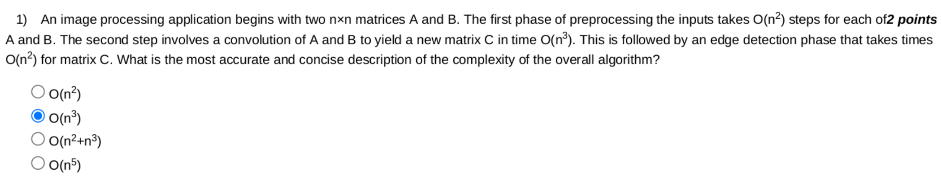
Problem 1.

Slide 3


Big O Notation
f(n) = log(n) + 7 | g(n) =
f(n) = n³ + log(n) | g(n) =
f(n) = n² + 2^{n} | g(n) =
O(log(n)) — logarithmic
O(n³) — polynomial
O(2^{n}) — exponential
https://en.wikipedia.org/wiki/Big_O_notation https://www.freecodecamp.org/news/big-o-notation-explained-with-examples/

Slide 4
Problem 1.
SOLUTION First step: Preprocessing - O(n²) + O(n²)
Second Step: Convolution - O(n³)
Third Step: Edge detection - O(n²)

Slide 5
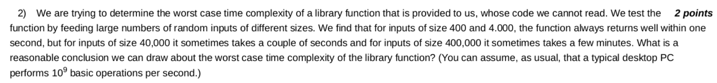
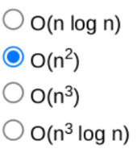
Problem 2.
SOLUTION

Slide 6
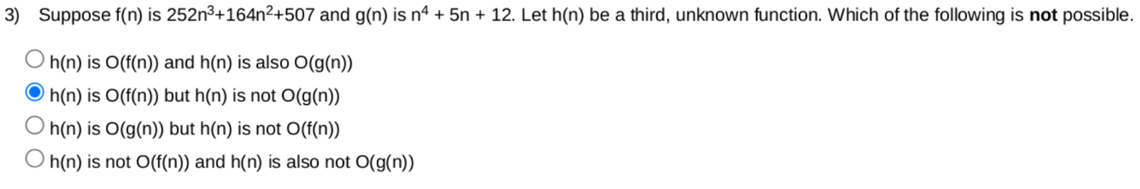
Problem 3.
SOLUTION

Slide 7
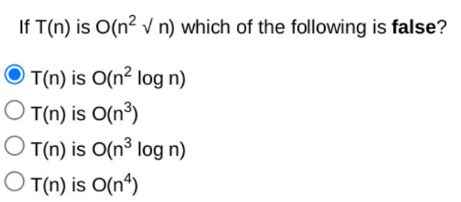
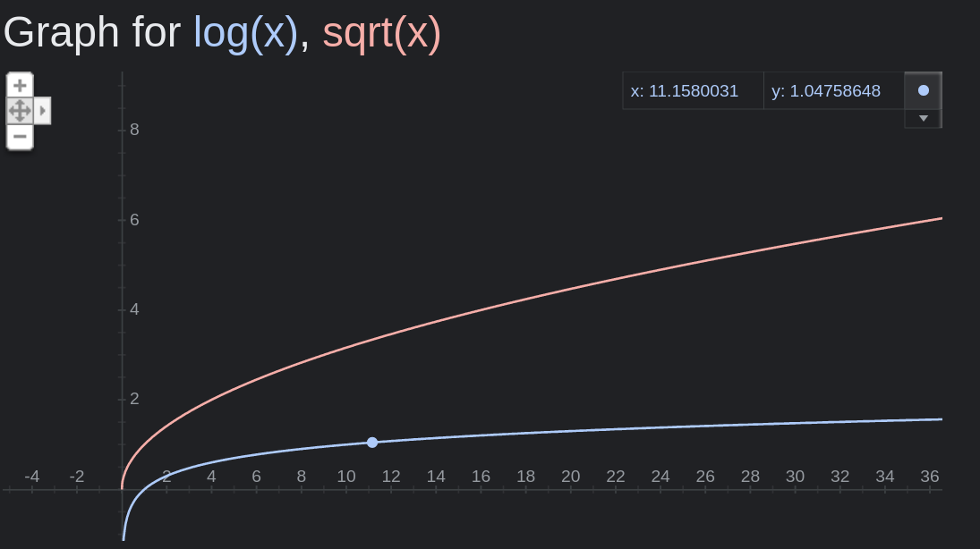

Problem 4.
SOLUTION

Slide 8
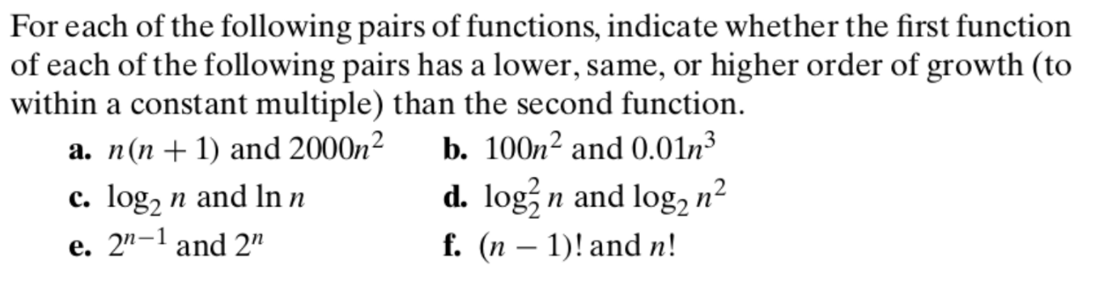
Problem 5.

Slide 9
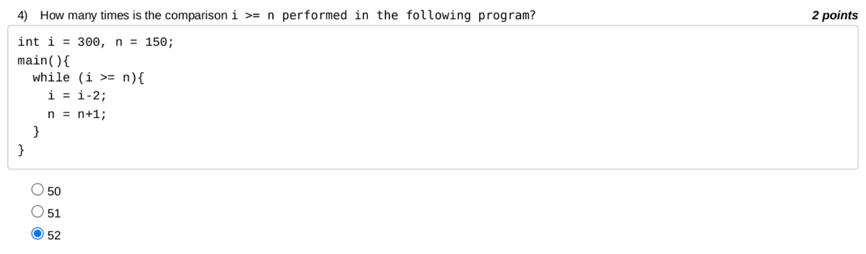
Problem 6.

Slide 10
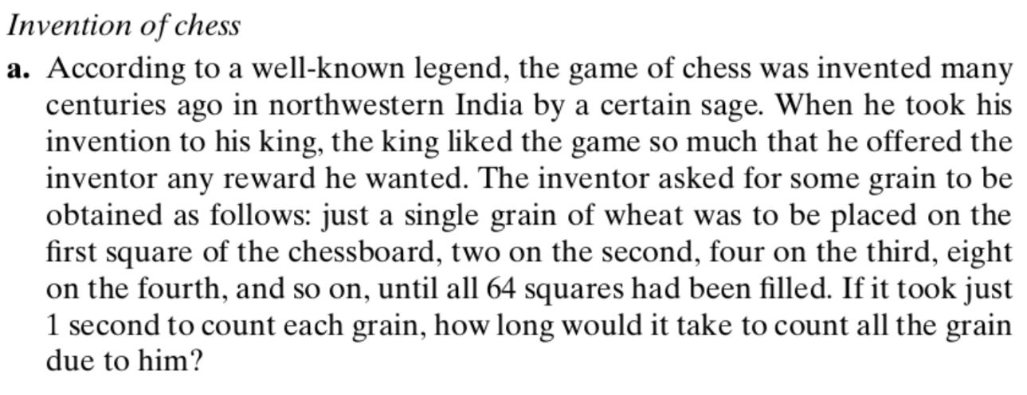
Problem 7.

Slide 11
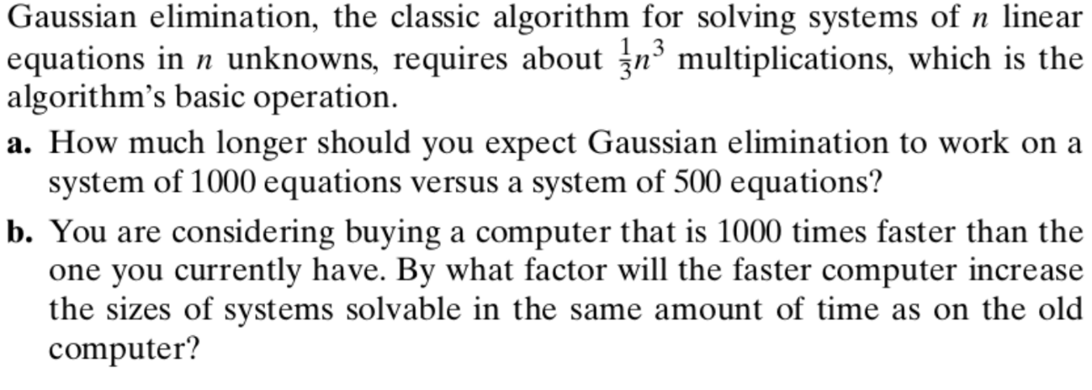
Problem 8.

Slide 12
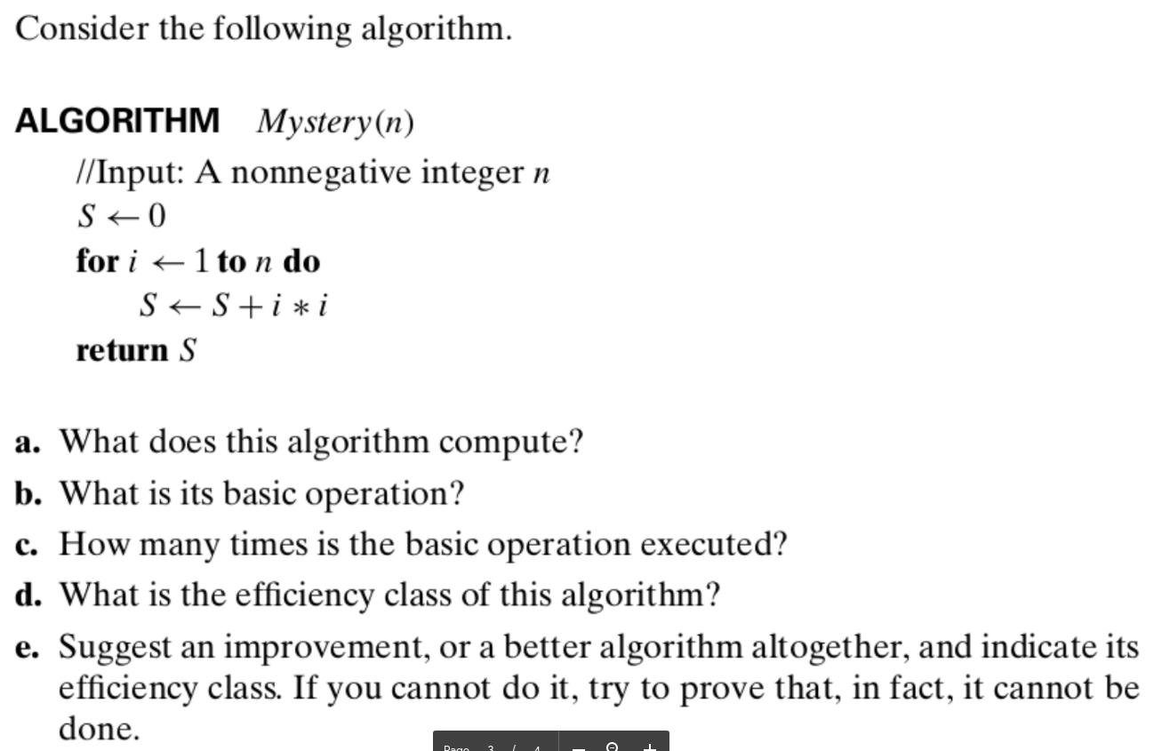
Problem 9.

Slide 13
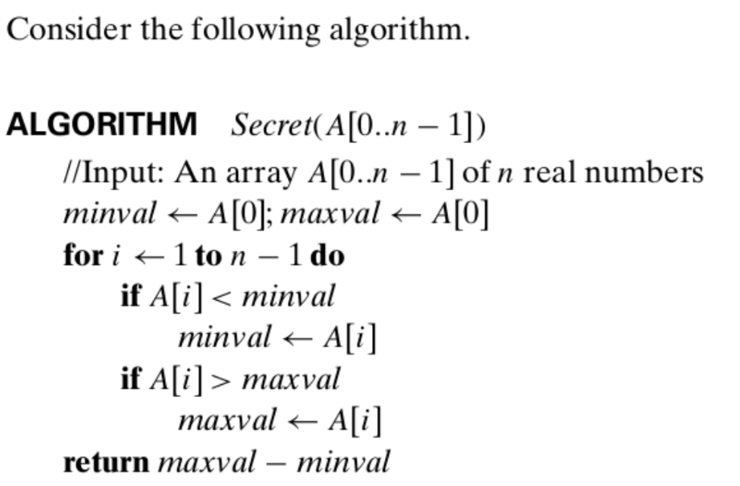
Problem 10.

Slide 14
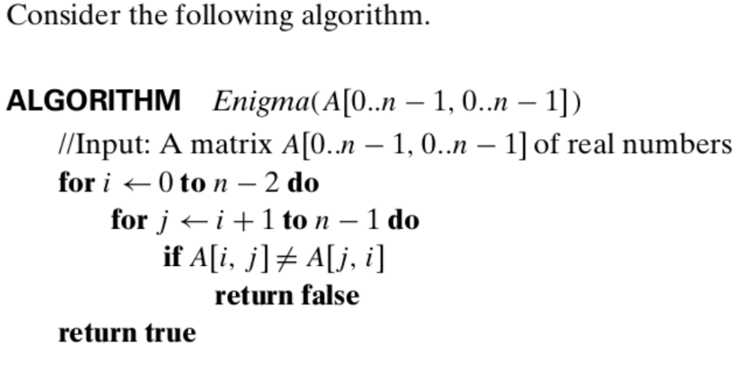
Problem 11.

Slide 15
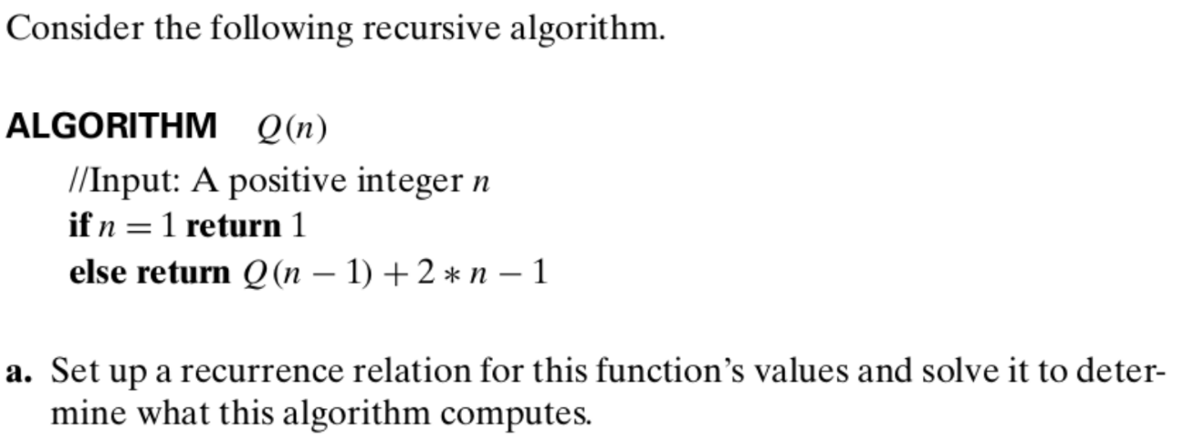
Problem 12.

Slide 16
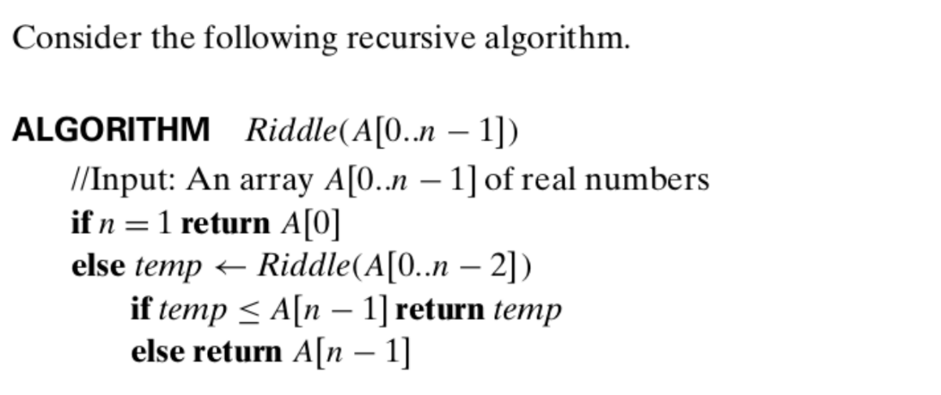
Problem 13

